Slide 1













SHOULDYOUBUY
By: Sutherland Brown, Kamsi Dozie, Alyssa Okosun & Jonathan Obas

Slide 2
TABLE OF CONTENTS
01
02
PRODUCT
DEVELOPMENT
INFO ON WHAT shouldyoubuy
INFO ON THE DEVELOPMENT OF THE shouldyoubuy
03
04
BENEFITS
COMMUNITY EFFECT
INFO ON THE BENEFITS OF shouldyoubuy
INFO ON HOW shouldyoubuy EFFECT INFLUENCES AND AFFECTS THE COMMUNITY
05
CONCLUSION

Slide 3
SHOULDYOUBUY? INTRODUCTION
01

Slide 4

WHAT IS ShouldYouBuy?
ShouldYouBuy is a webpage that assists in one’s financial planning and gives one information on whether it’s a good idea to spend their money on this or not.
It advices you on what your short term and long term plans could be towards buying what you want to buy

Slide 5
DEVELOPMENT OF SHOULDYOUBUY?
ORIGINS
CONCEPT
ShouldYouBuy was developed to aid people from all backgrounds make informed spending decisions.
ShouldYouBuy incorporates the use of OpenAI Application Programming Interface (API) to answer questions on whether or not your financial decision is a good decision or not. It also incorporates the use of the OpenAi api to assist you in making long term plans based on those financial decisions

Slide 6
DEVELOPMENT
PLANNING
BACKEND
FRONTEND
SET UP A FIGMA TO VISUALIZE OUR DESIGN
SPLIT INTO TWO SUBGROUPS TO DEAL WITH BOTH THE BACKEND AND FRONT END DEVELOPMENT
INCORPORATE AI USING THE OPENAI API
CREATE A DATABSE AND SET UP THE LINKING OF THE TABLES
CONNECT THE DATABSES TO THE FRONTEND
DEVELOP THE SHOULDYOUBUY WEBSITE BASED OFF OF THE FIGMA
DEVELOP THE WEBSITE USING TYPESCRIPT

Slide 7
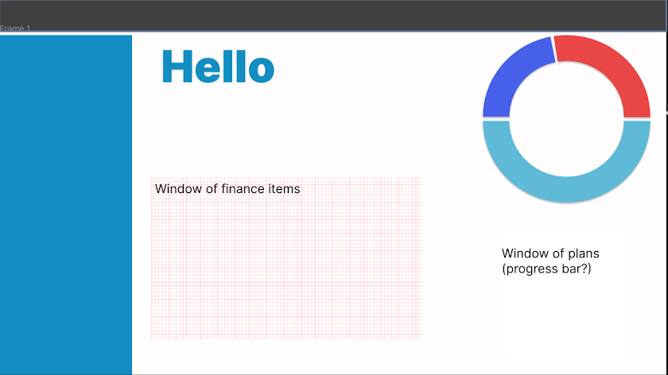

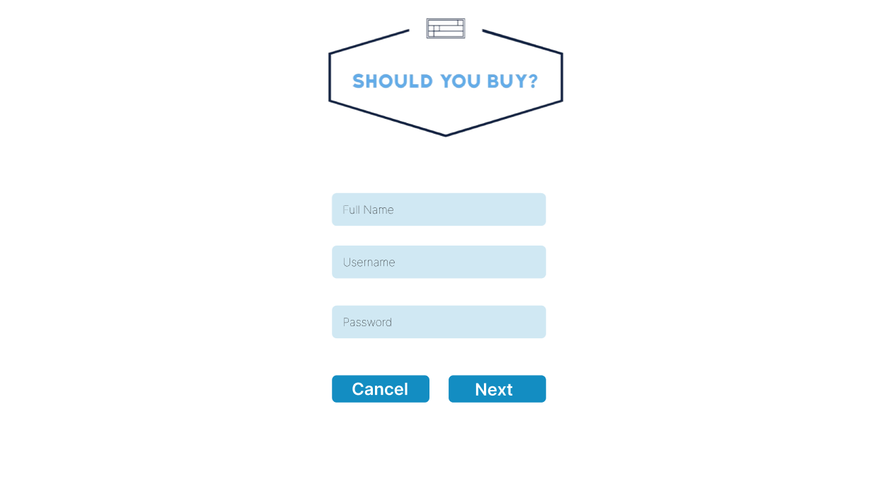
FRONTEND

Slide 8
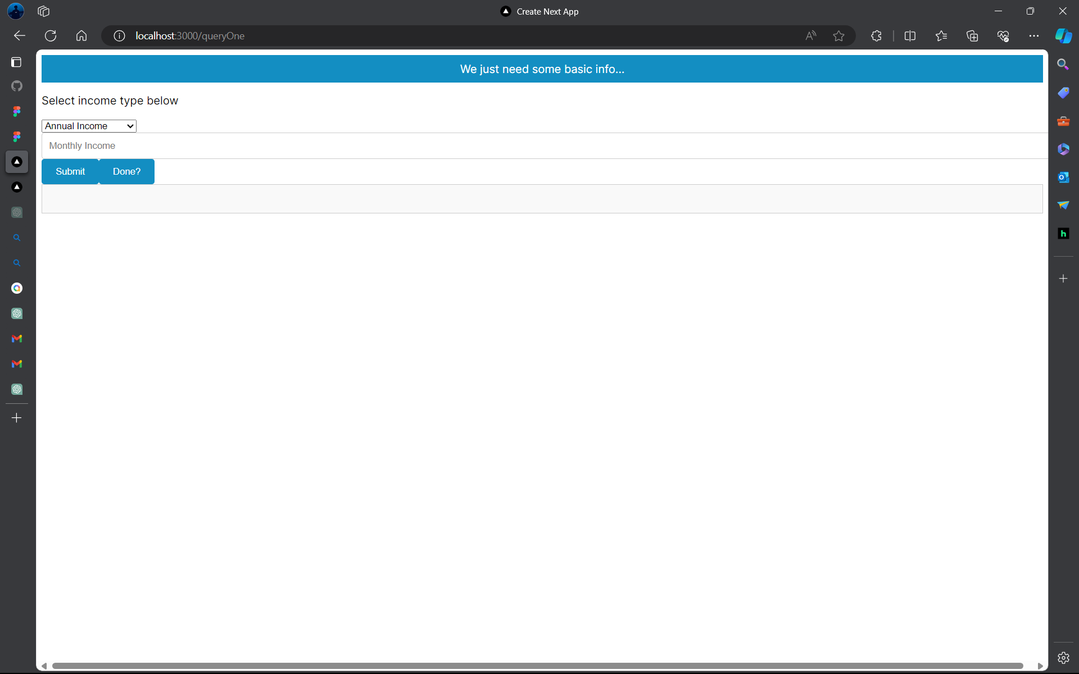
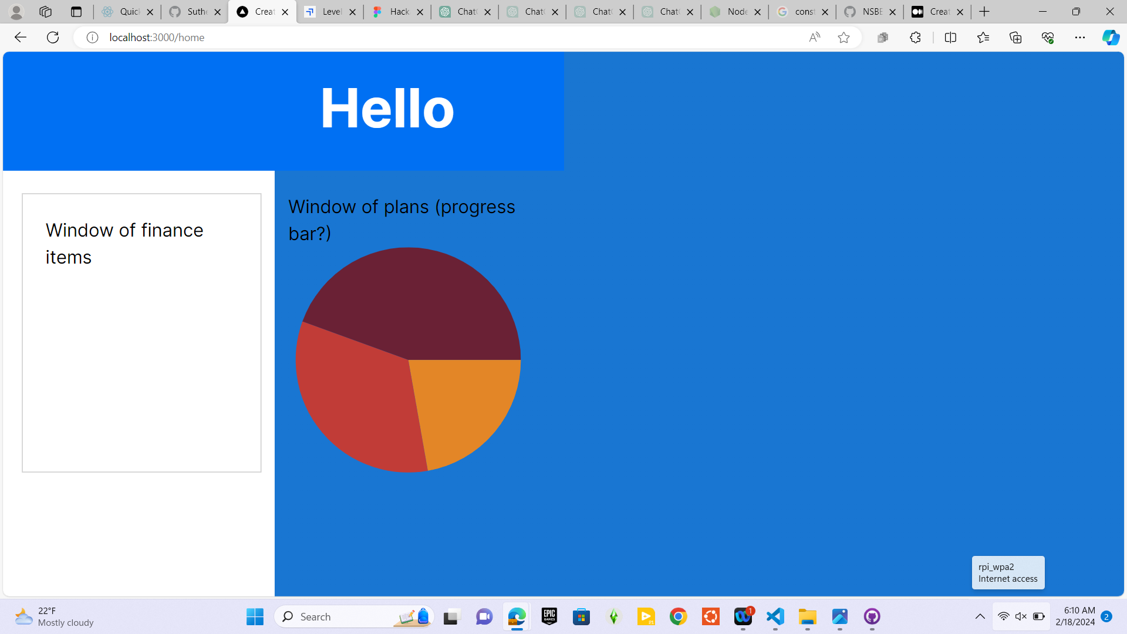
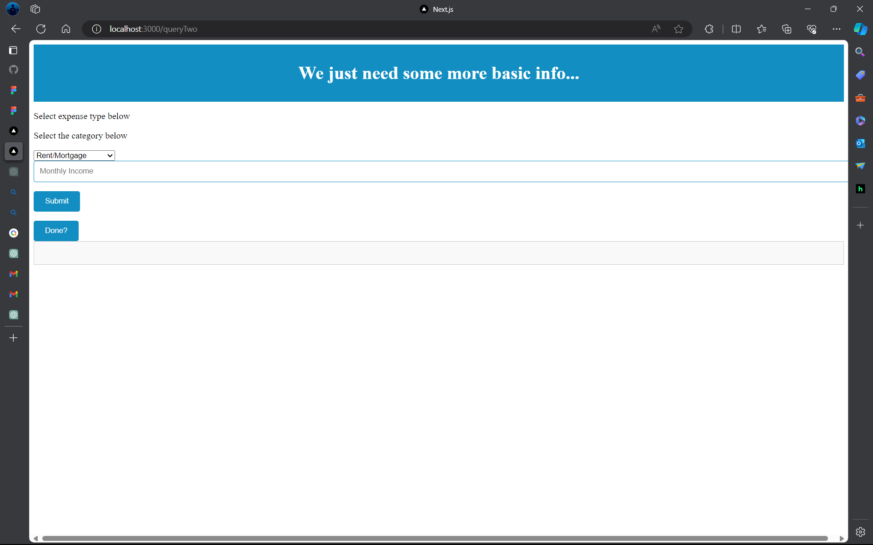
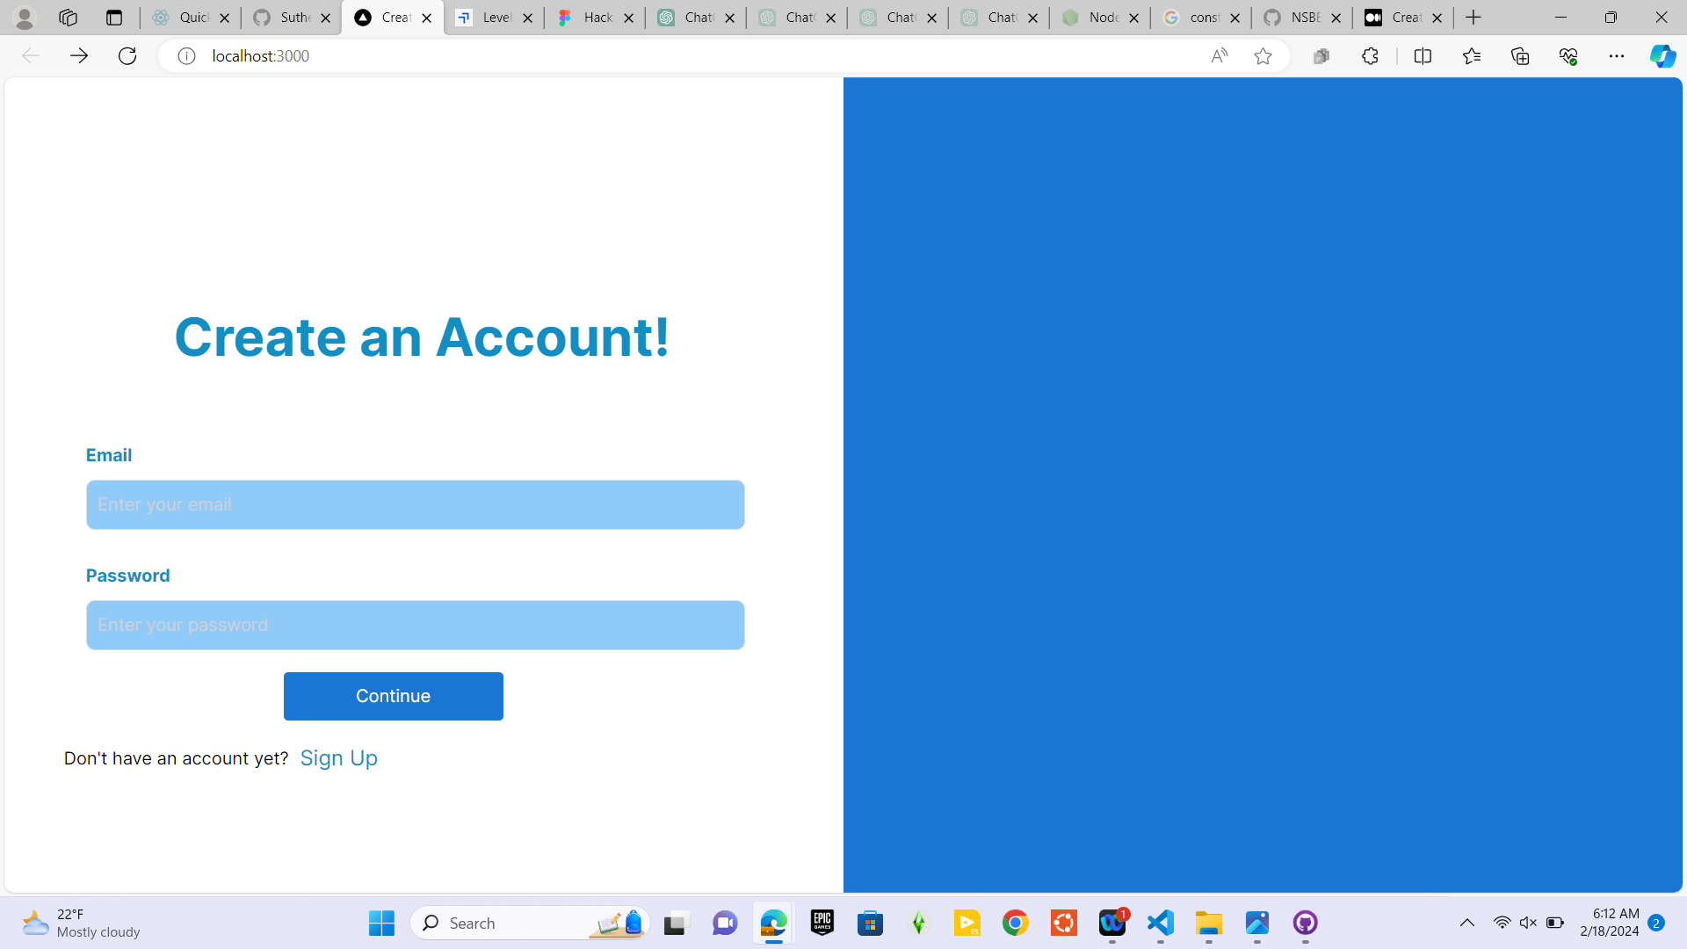
FRONTEND CONT.

Slide 9
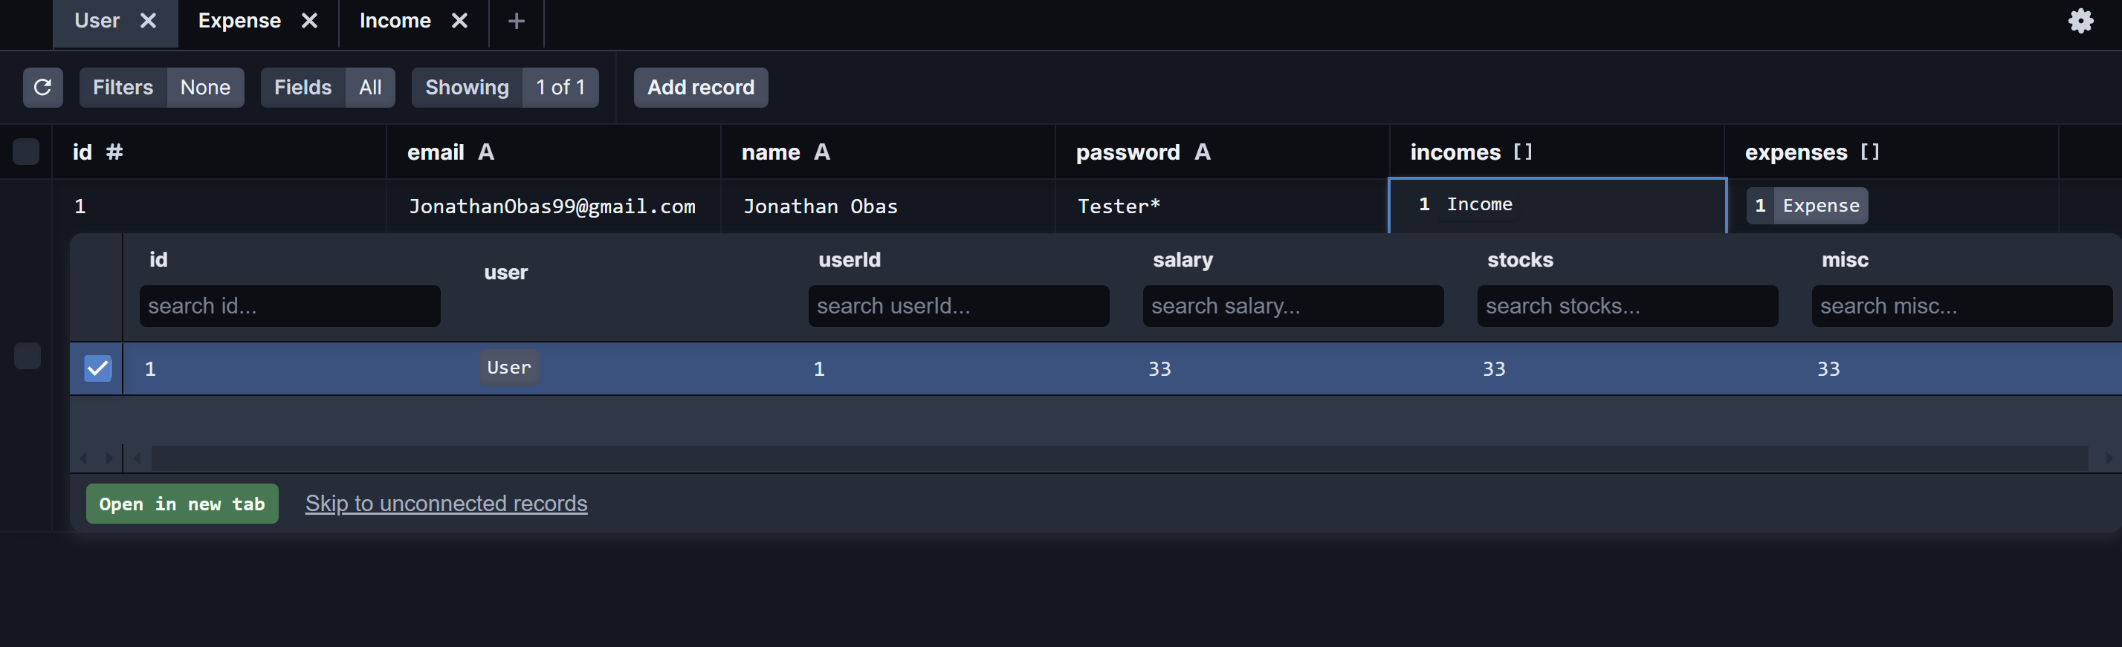
BACKEND

Slide 10
NEXT STEPS
LINK THE DATABASE TO THE FRONT END
FINSIH IMPLEMENTING THE OPENAI API TO THE FRONTEND

Slide 11
EFFECT ON THE COMMUNITY
ShouldYouBuy could improve the community in several ways. Firstly, by providing accessible financial education and guidance, it empowers individuals to make informed decisions, leading to better financial stability and independence. This, in turn, reduces the likelihood of financial crises within the community and promotes economic resilience. Additionally, ShouldYouBuy fosters a supportive online community where users can share tips, resources, and encouragement, creating a culture of collaboration and empowerment. By addressing the unique financial challenges faced by lower-income individuals and promoting inclusivity, ShouldYouBuy contributes to narrowing the wealth gap and fostering greater economic equality within the community. Finally, by encouraging responsible spending and saving habits, ShouldYouBuy promotes long-term financial health, ultimately leading to a stronger and more prosperous community overall.

